Slide 1
Introduction to week 4 – Renaissance learning and unlocking your potential
By Barbara Oakley, PhD

Slide 2
Learn using metaphor and analogy
Work profitably with teammates
Perform well on tests

Slide 3
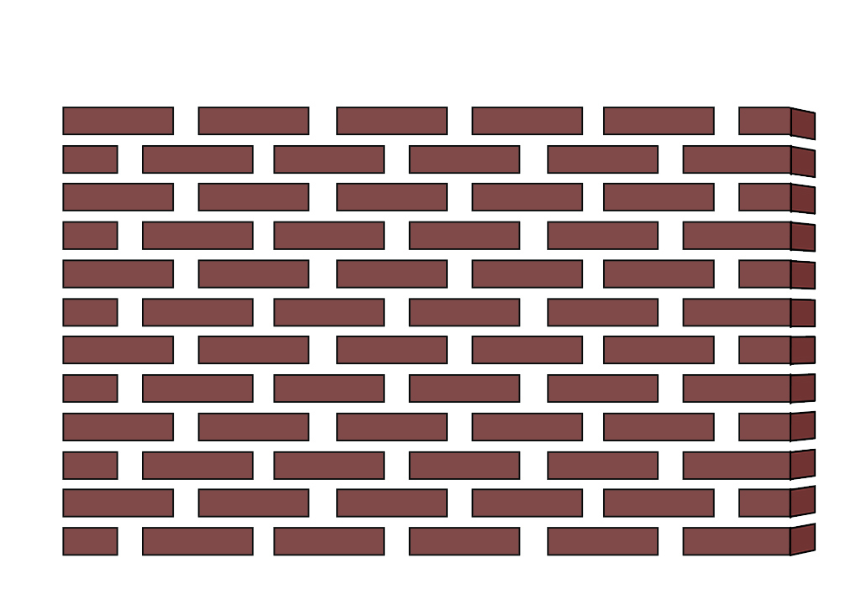
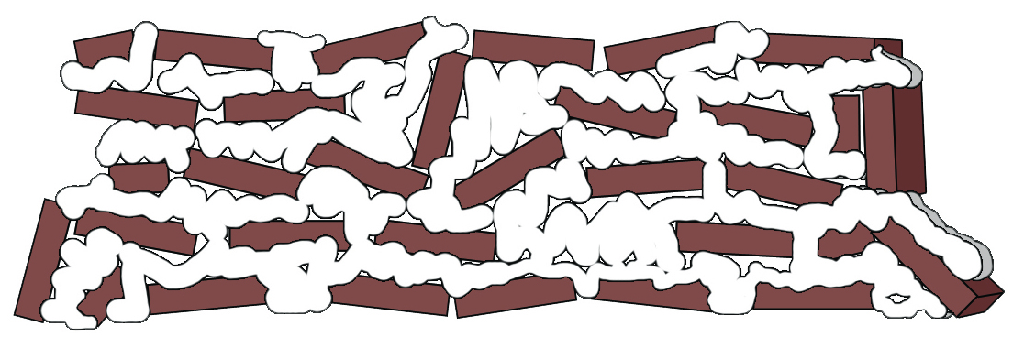
большо́й большо́го
больши́х большо́му
больши́м большу́ю

Slide 4
Illustration credits
Brick walls, ©Kevin Mendez, 2013

